Slide 1
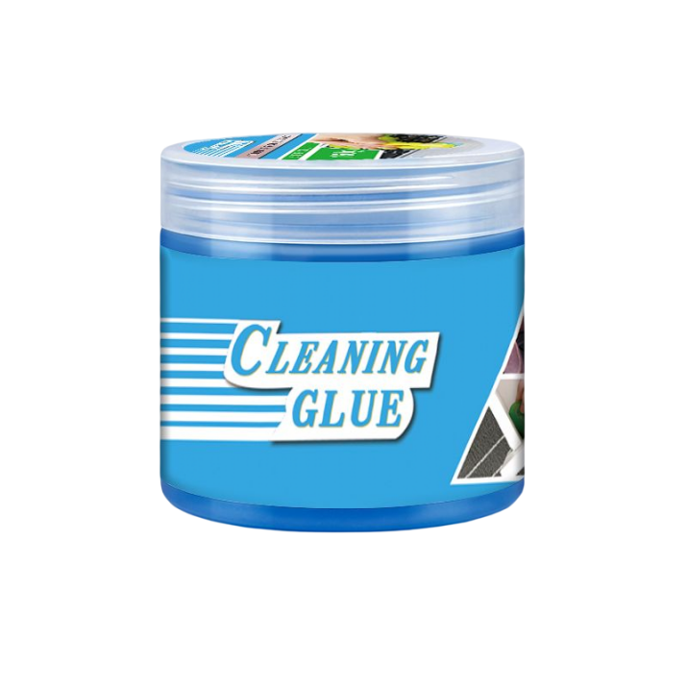
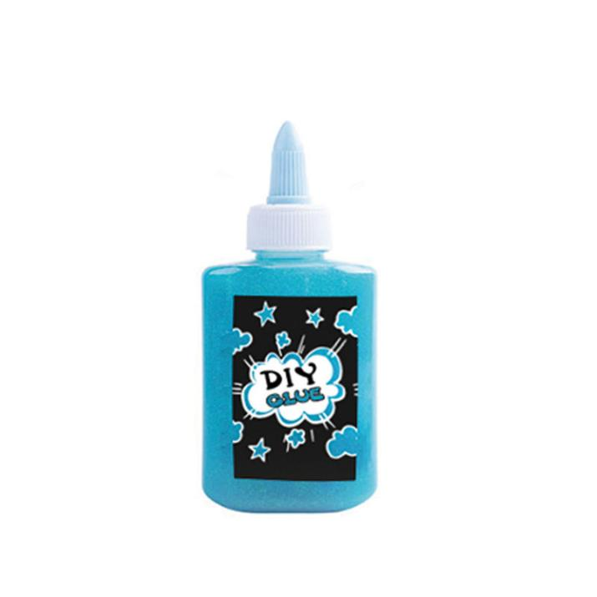
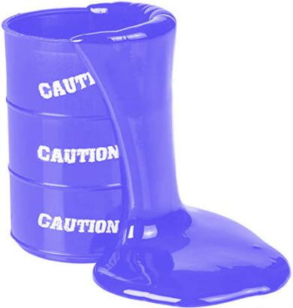
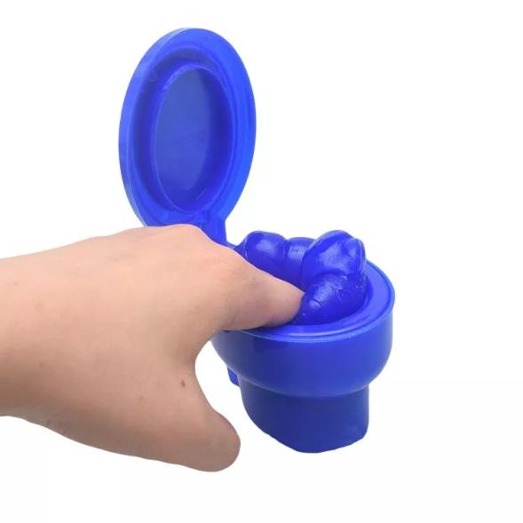
YIWU JITENG TOYS CO.,LTD
Hey,my Potential business partners.just have a look.
We have CE SQP EN71 BSCI certificates!(Certificate is on the next page)
product:playdough/slime/clay/mud/putty/DIY glue...
延迟符

Slide 2
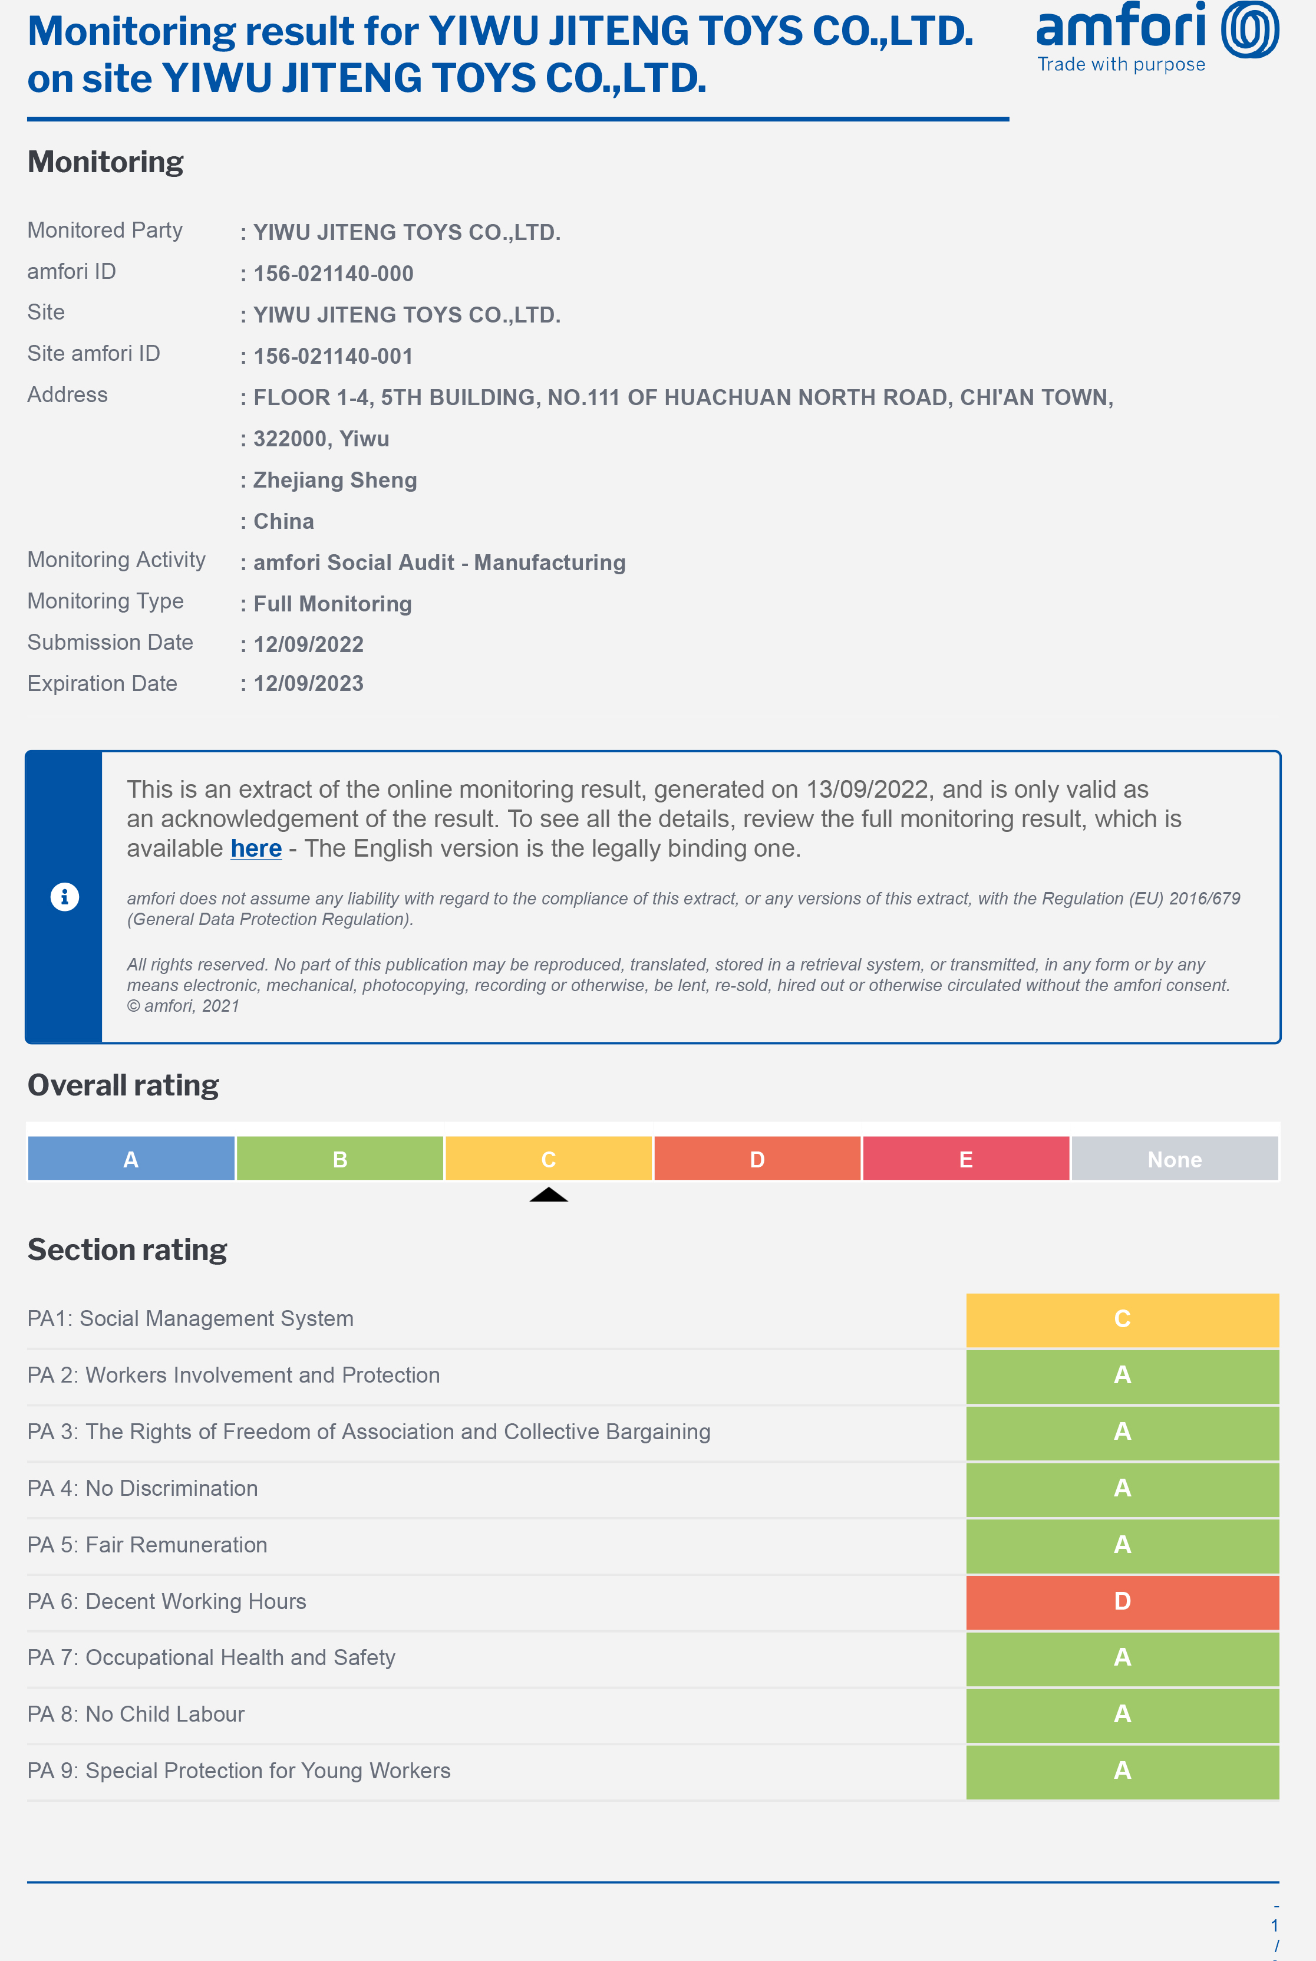
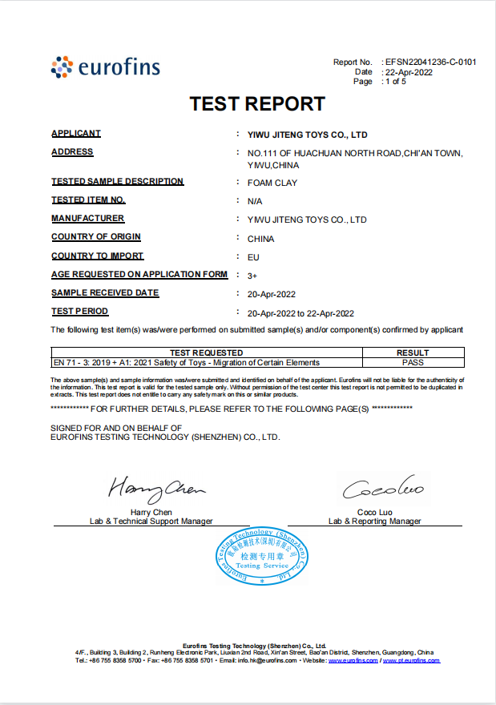
amfori ID:156-021140-000
Report NO :EFSN22041236-C-0101
延迟符

Slide 3
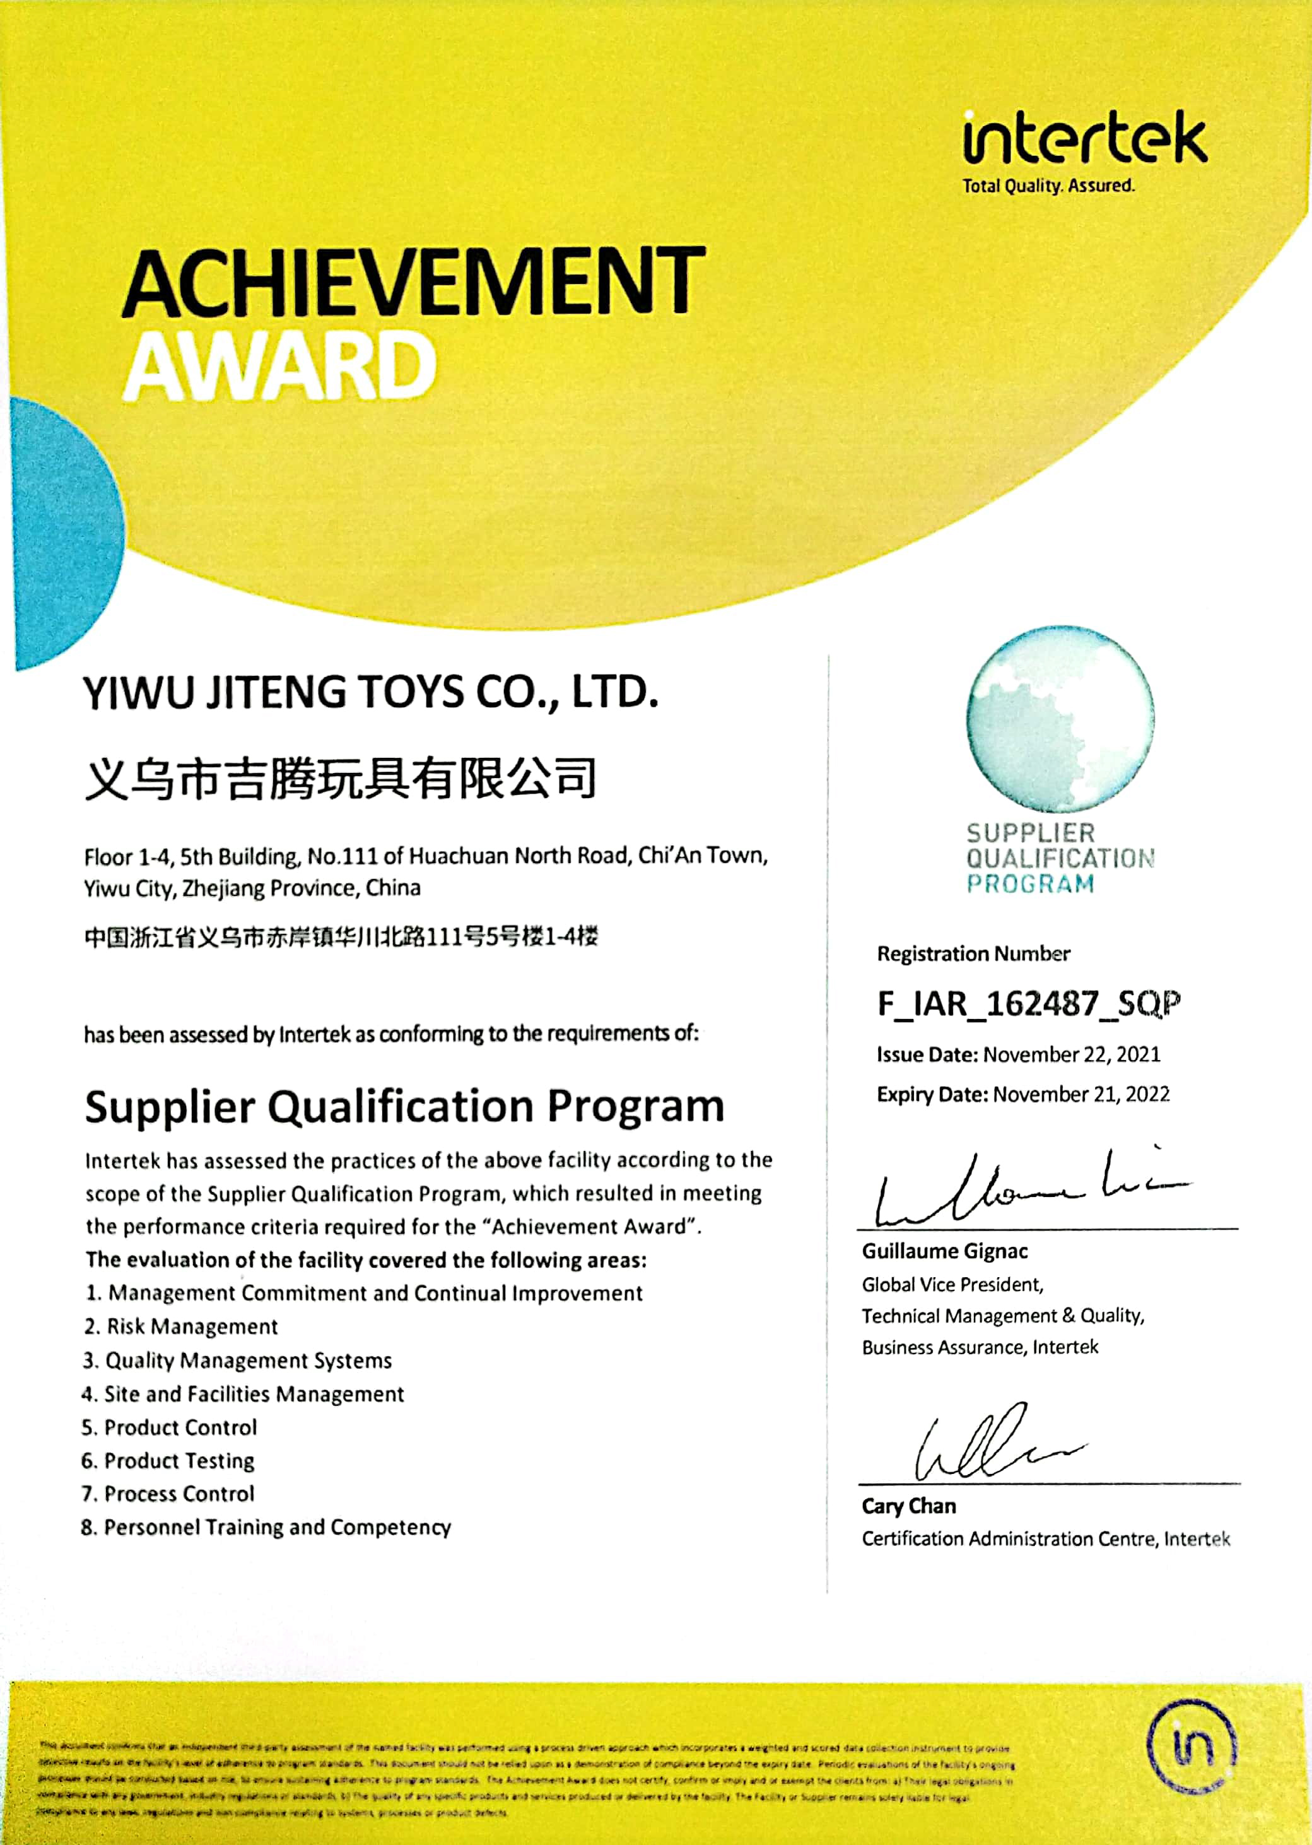
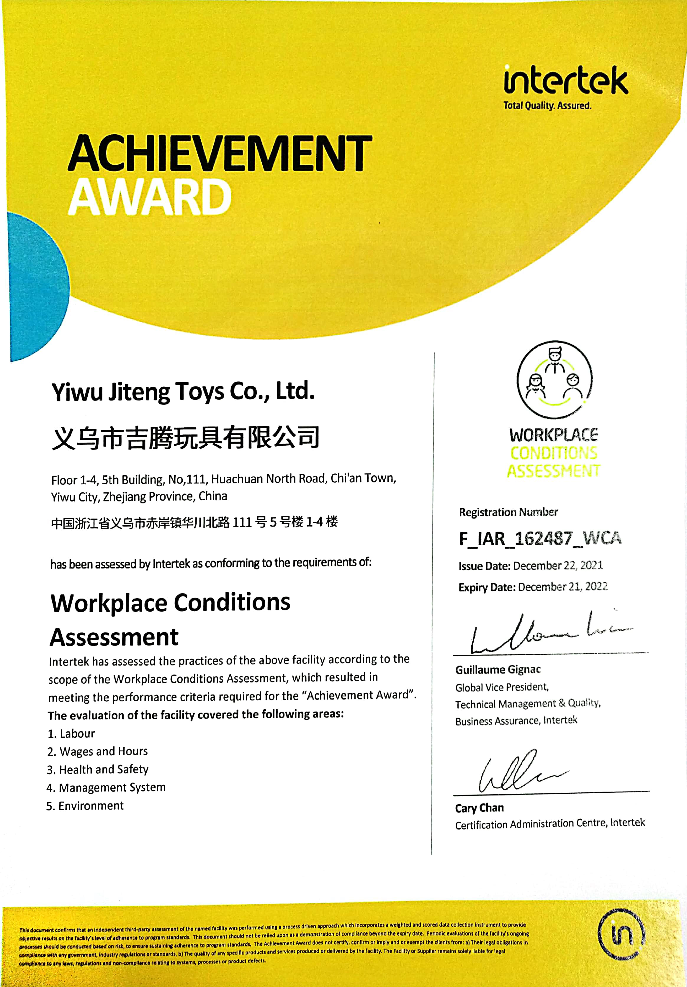
Registration Number:F—IAR—162487—SQP
Registration Number:F—IAR—162487—WCA

Slide 4
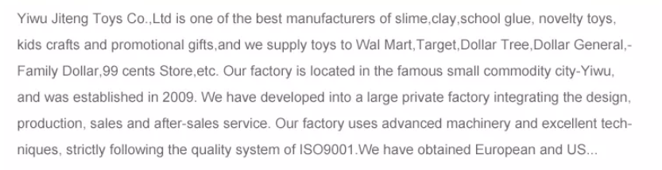


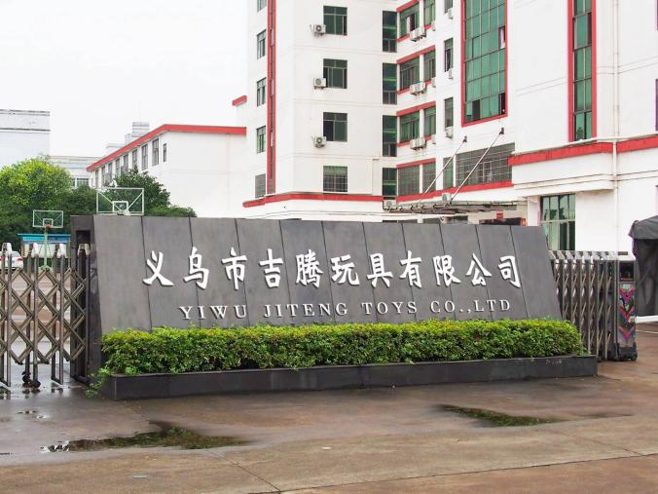
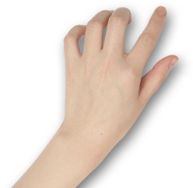
Enterprise
introduction
延迟符

Slide 5
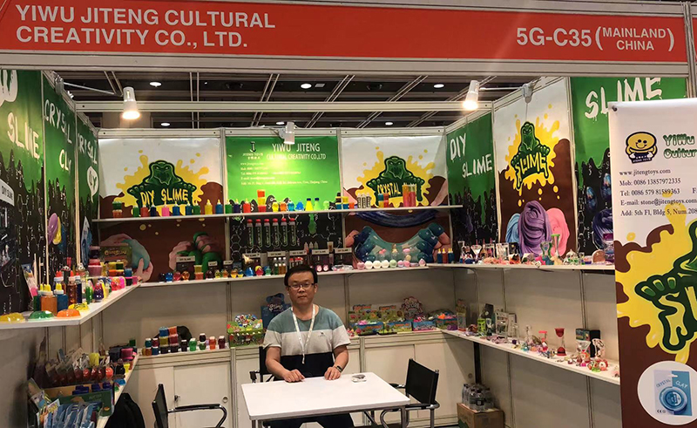
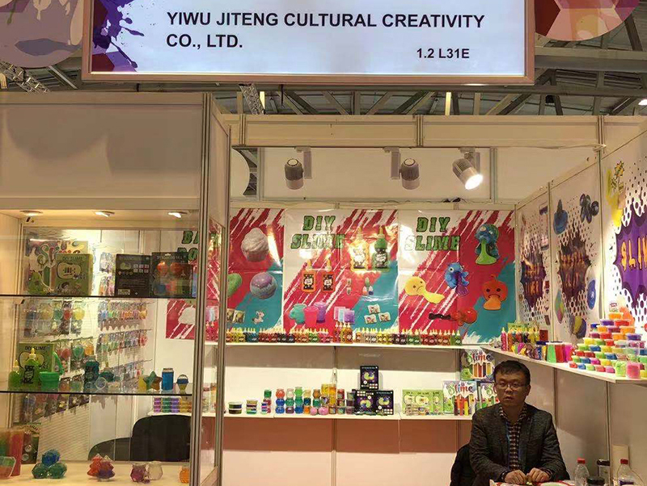
Exhibitions that we have attended
HongKong MEGA Show 2019
Paperworld 2020

Slide 6


We are a manufacturer from Yiwu, Zhejiang, China. We have established business relationships with many well-known customers
......

Slide 7
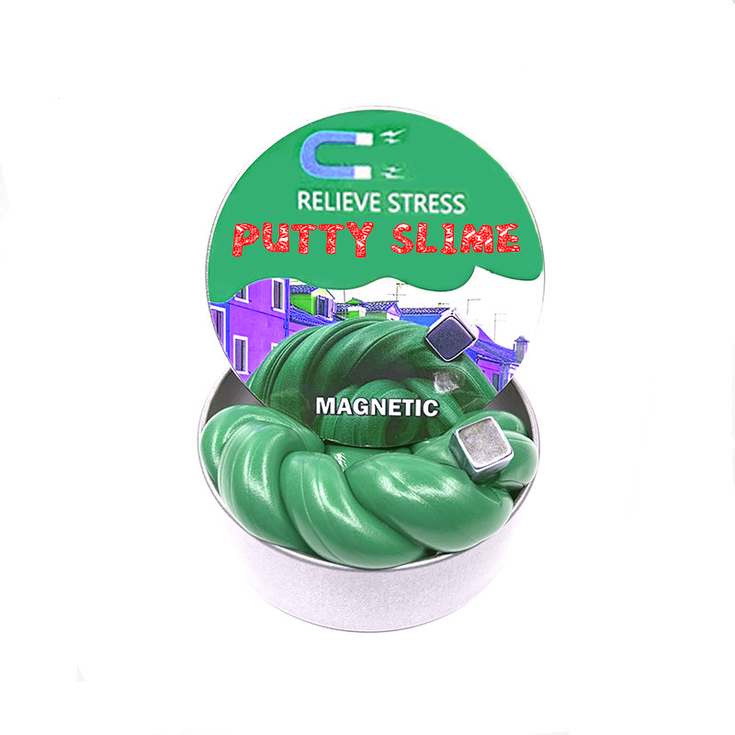
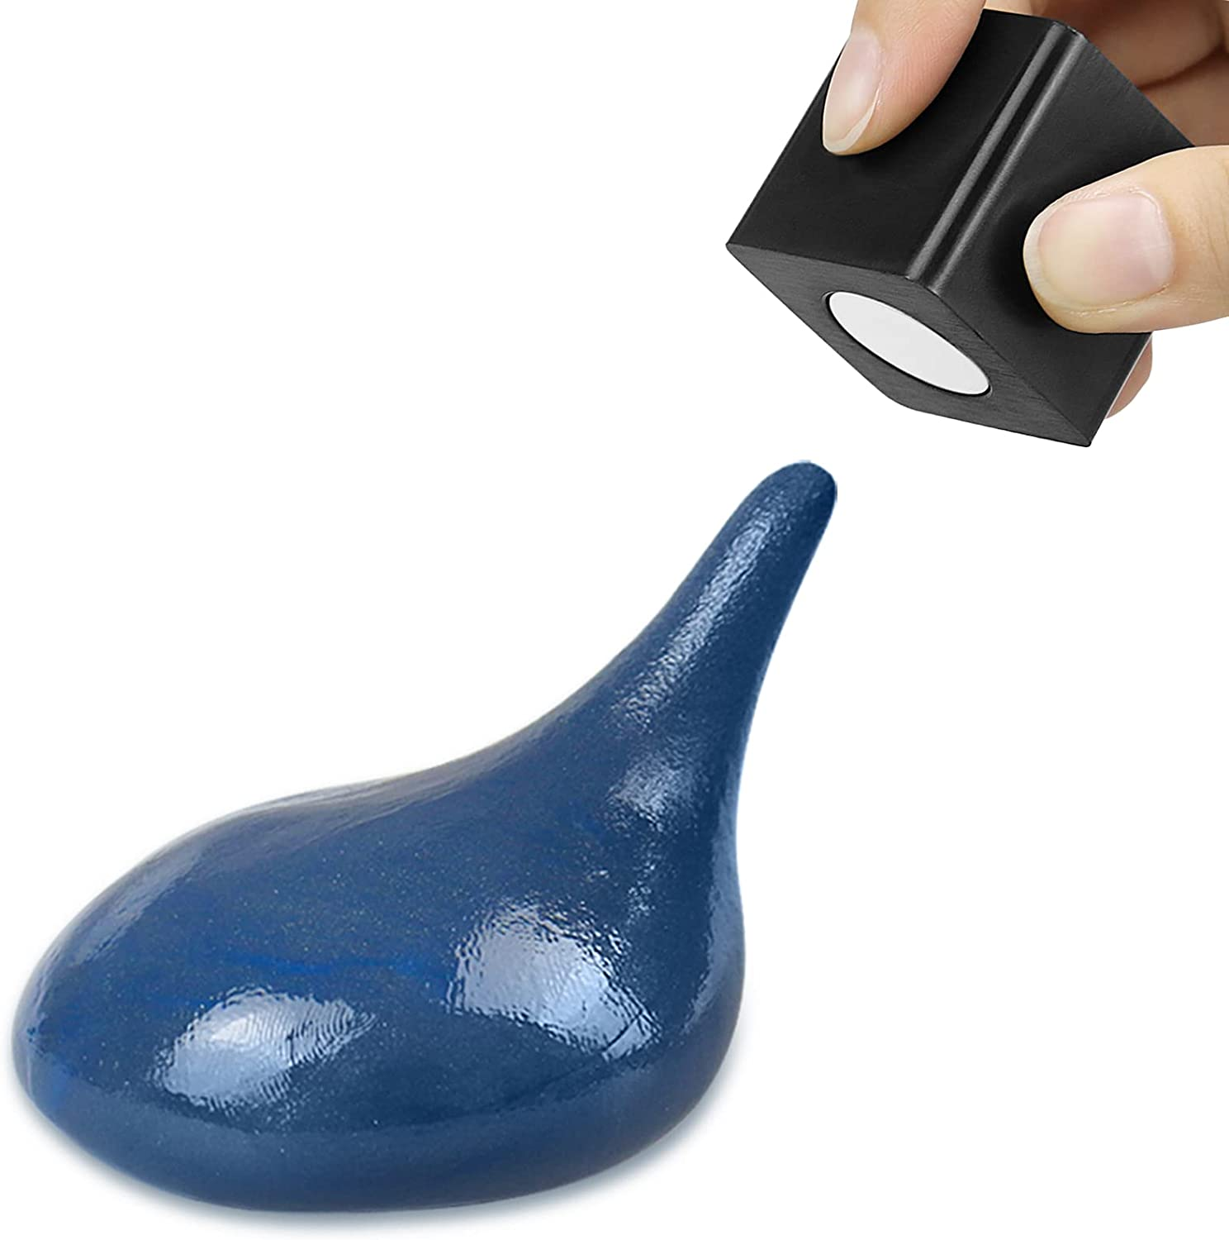
Part of the product display
This good design hand slime black putty is really magnetic, which can be moved freely. It is made of silicon grease material which is non-toxic and has no harmful substances.
延迟符

Slide 8
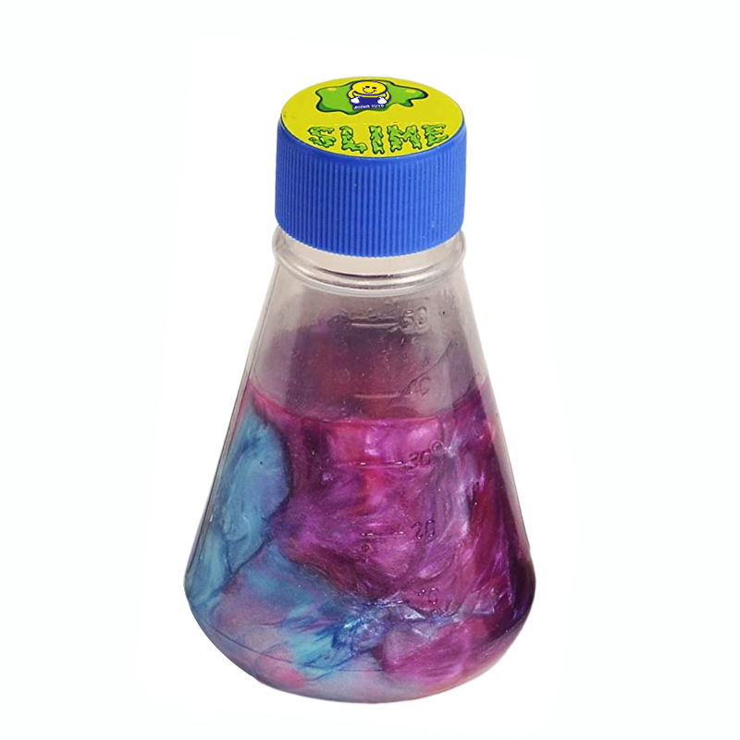
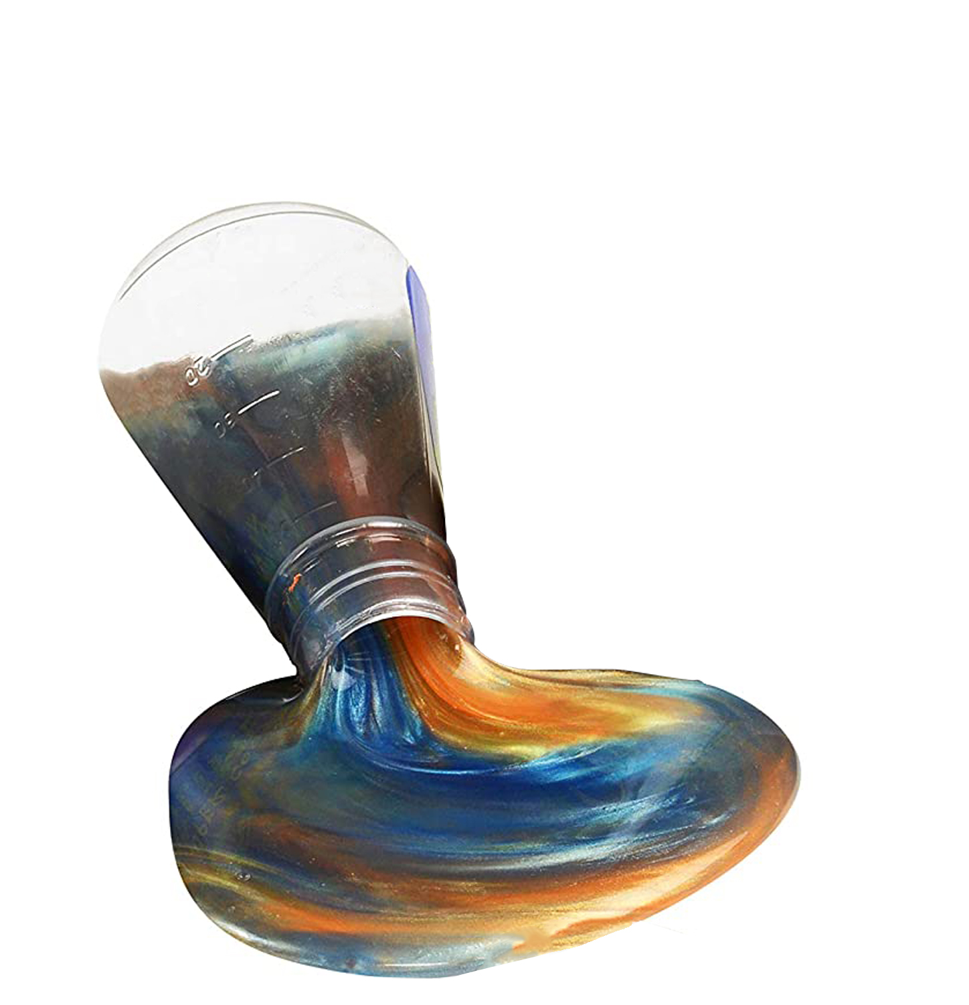
Part of the product display
The slime is cool, glossy, bright, super soft, non-sticky, kneading, squeezing, and spreading, giving children a different magical experience.
延迟符

Slide 9
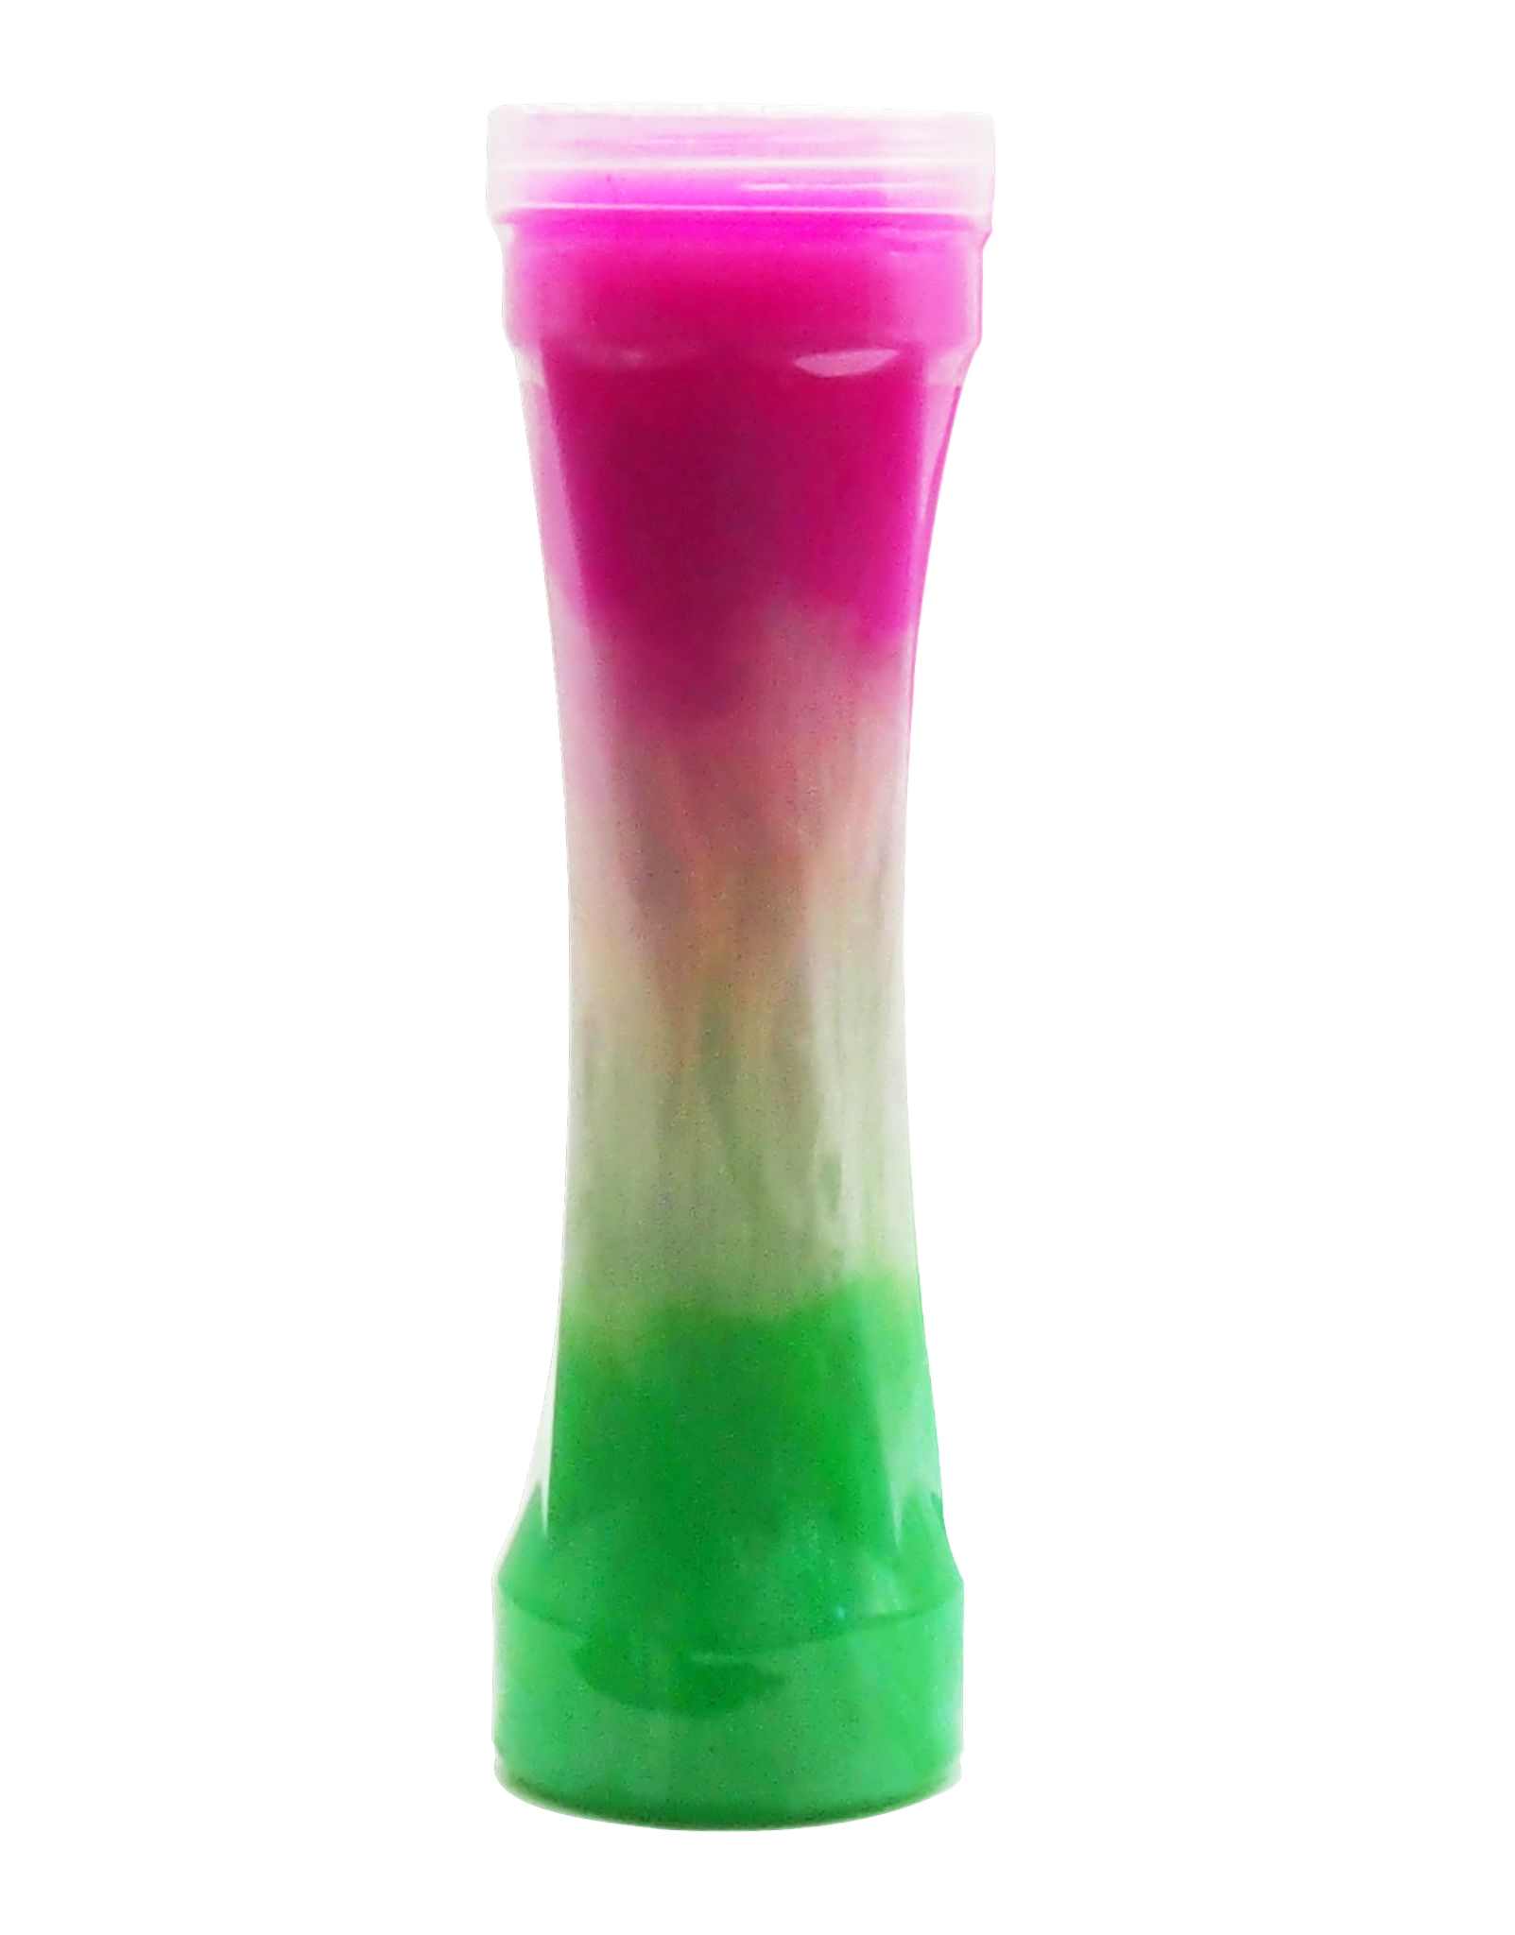
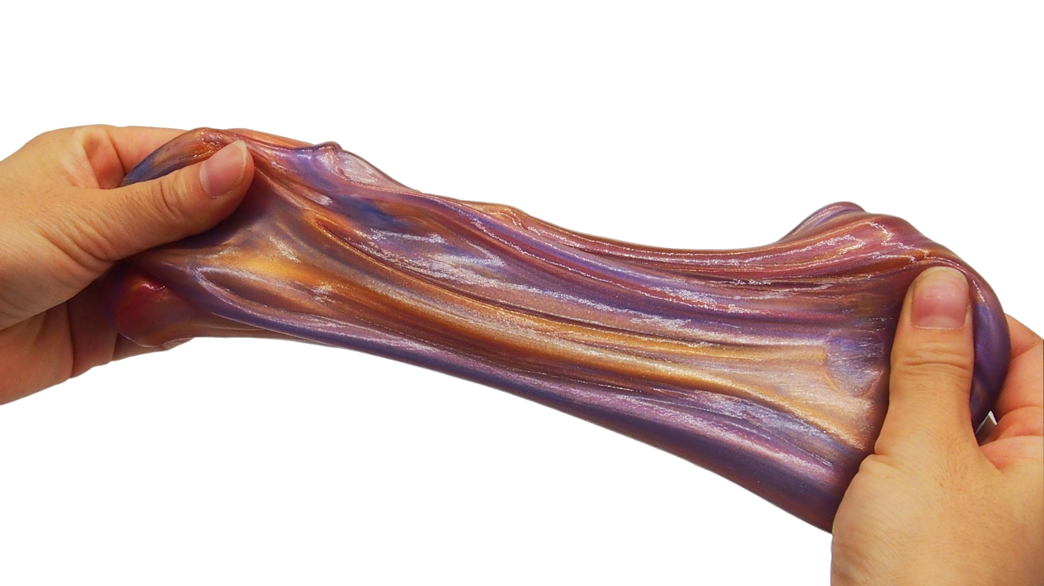
Part of the product display
The slime is cool, glossy, bright, super soft, non-sticky, kneading, squeezing, and spreading, giving children a different magical experience
延迟符

Slide 10
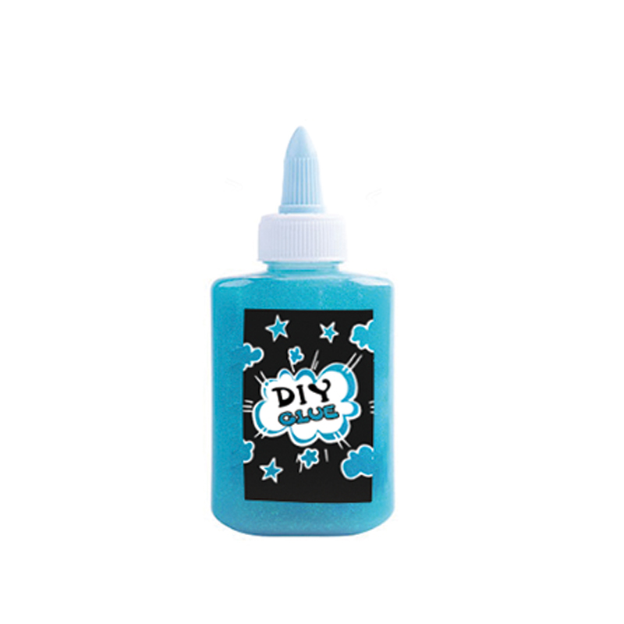
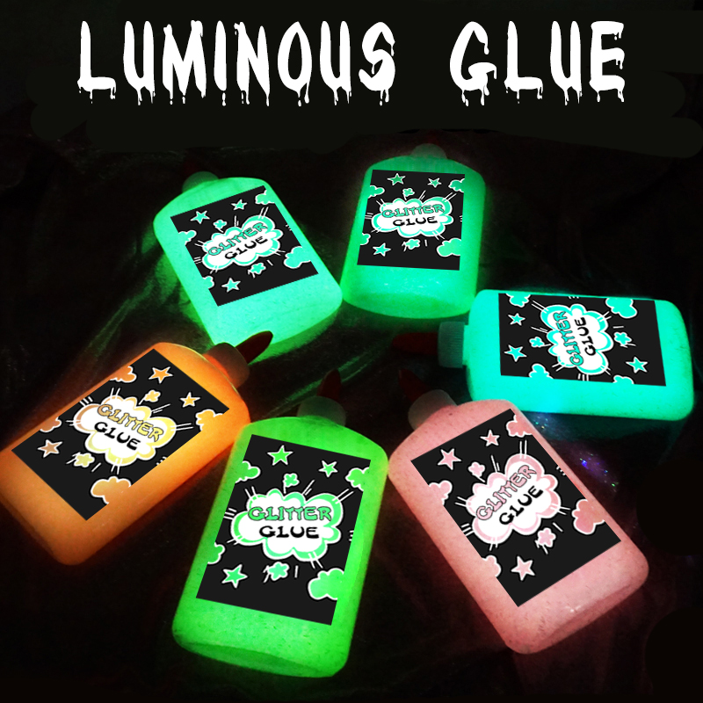
Part of the product display
Add a bold, glittery pop to your projects and homemade slime!
Safe, washable, non-toxic and no-run formula.Great for creating
slime at home or in the classroom!
延迟符

Slide 11
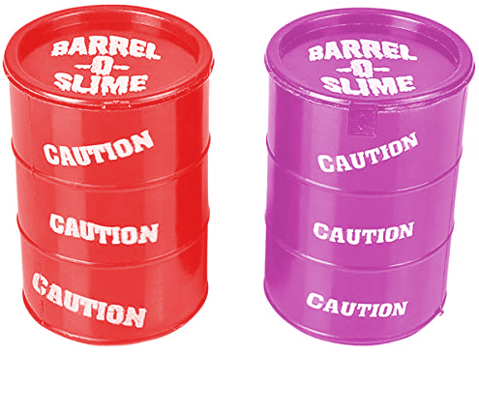

Part of the product display
Stress Relief and Release, Calming, Relaxing, Focus, Concentration, Autism, Anxiety, Sensory toys, Memorial Day Sale, Independence, Classroom Box, Easter Basket, Party Supplies, Treasure Chest Box, For Children Kids boys or Girls & Adults.
延迟符

Slide 12
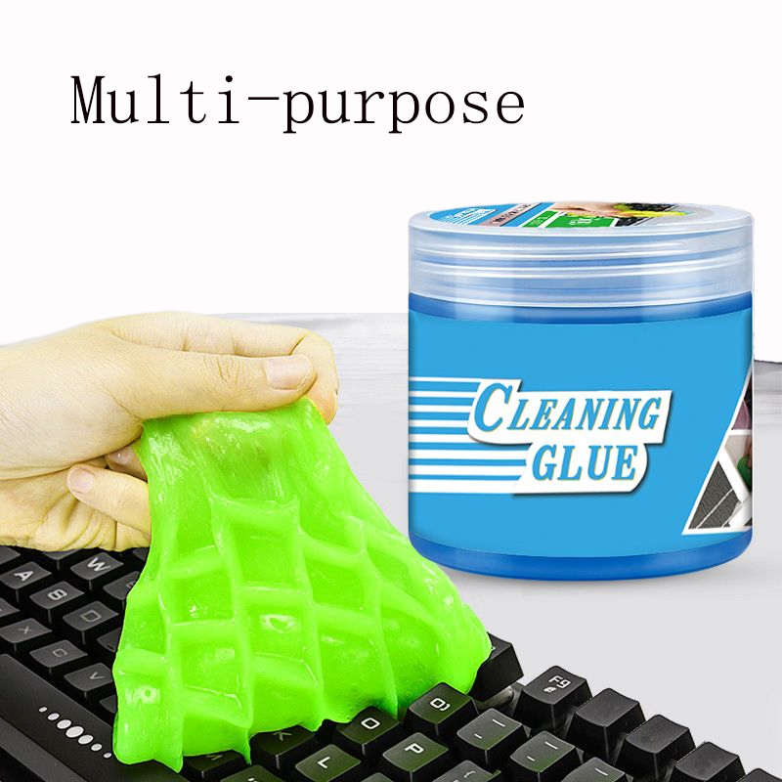
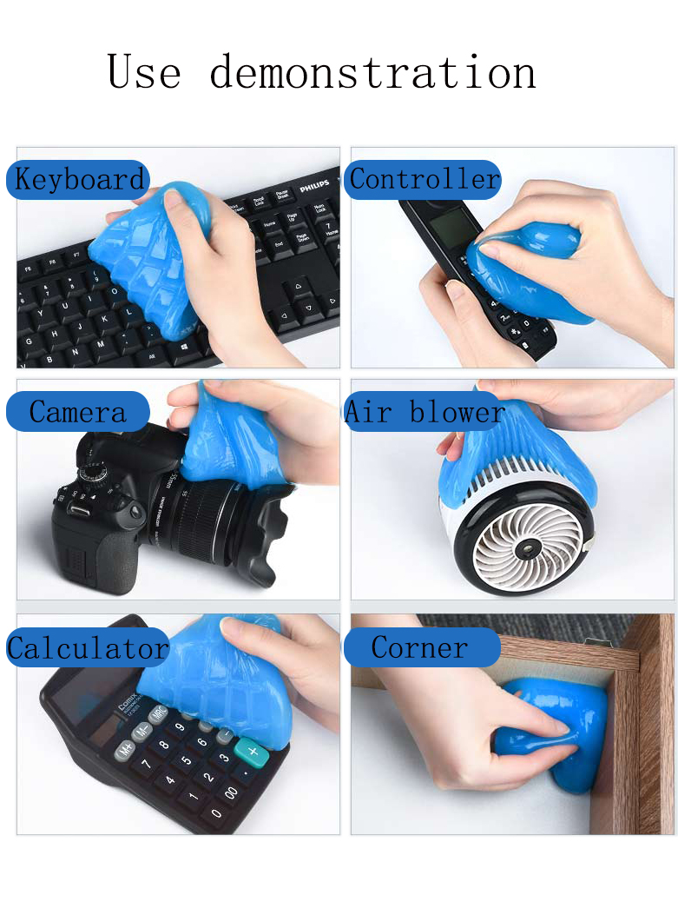
Part of the product display
This car cleaning gel is designed to clean car dash board, air vent, storage bins, cup holder, ashtray and other hard-to-reach corners. This cleaning gel also provides an all-fit dust cleaning tool for computes, keyboards, printers, laptops, speakers, appliances and desktop tower cases. The cleaning slime could easily pick up dust, debris, crumbs from all kinds of narrow crevices and corners.
延迟符

Slide 13
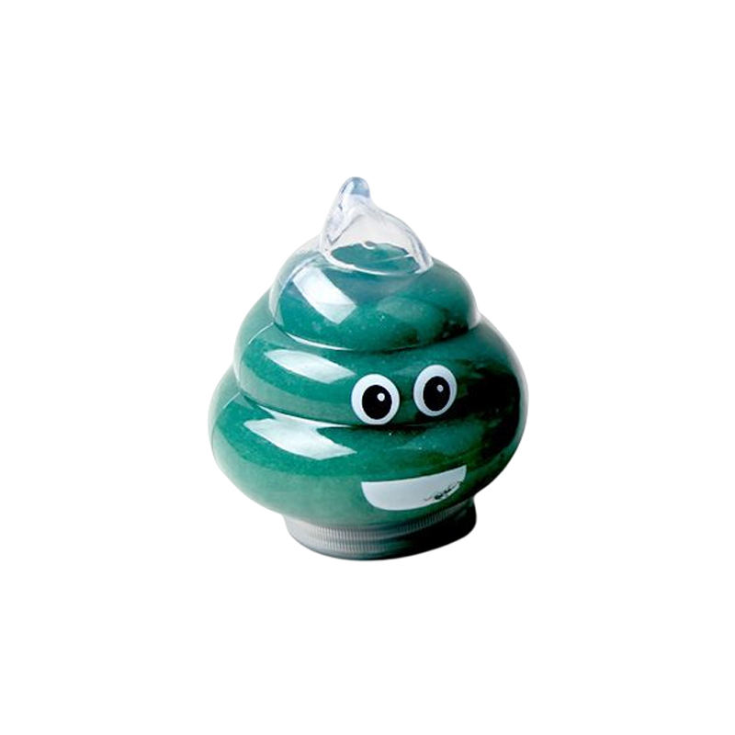
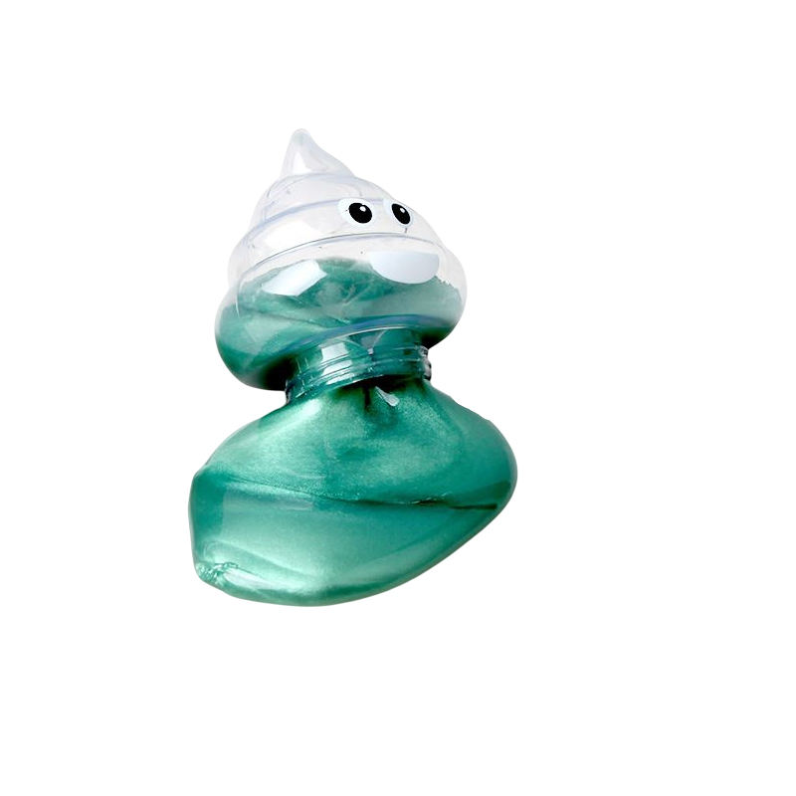
Part of the product display
Perfect birthday present or stocking stuffer for the holidays too. The possibilities are endless!It is made of silicon grease material which is non-toxic and has no harmful substances.
延迟符

Slide 14
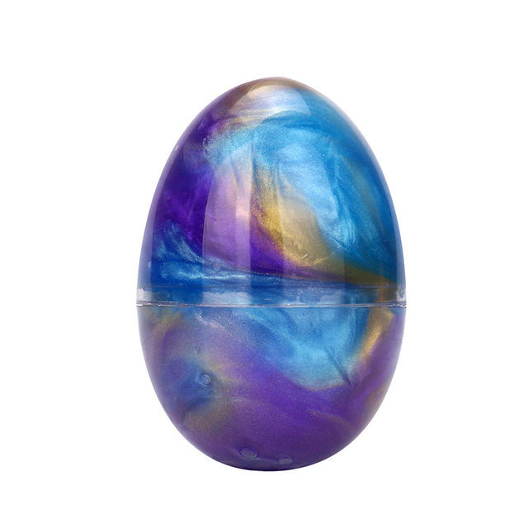
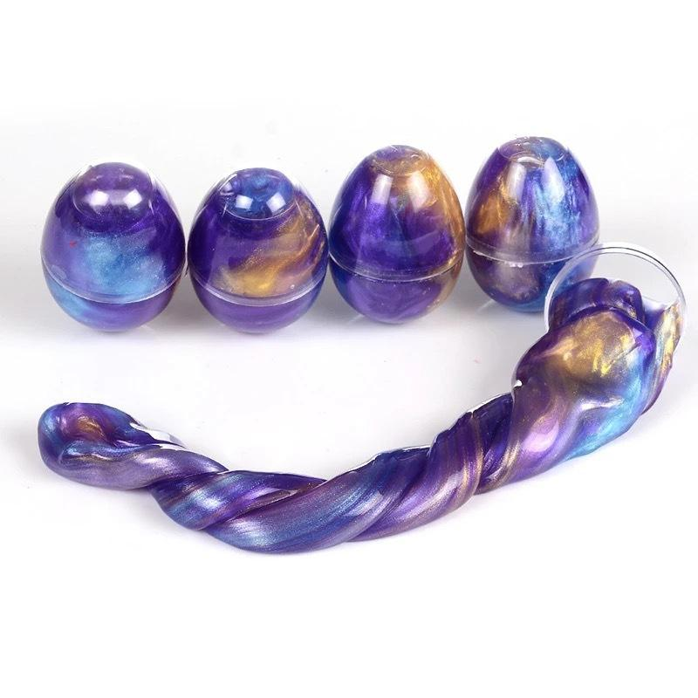
Part of the product display
slime eggs toy for kids, girls, boys, stocking stuffers, christmas gifts, christmas stockings, birthday gifts, school classroom rewards, carnival prizes, pinata, goodie bags, easter basket stuffers, easter egg fillers
延迟符

Slide 15
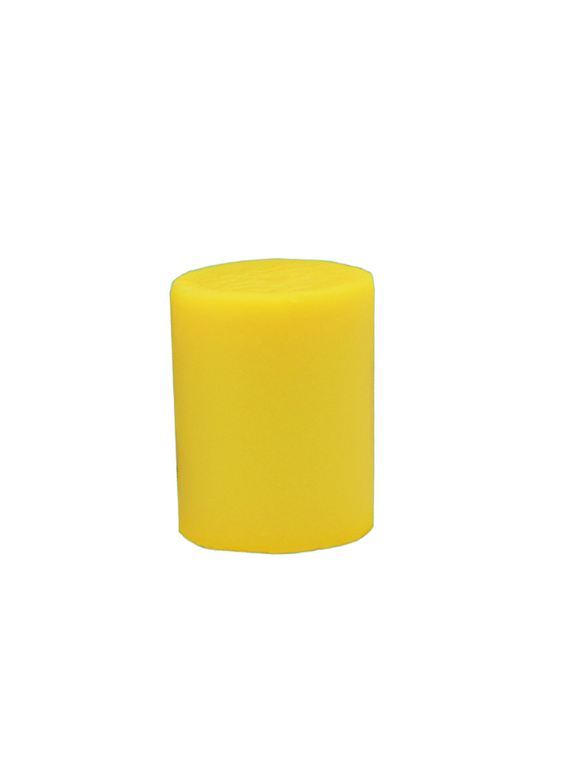
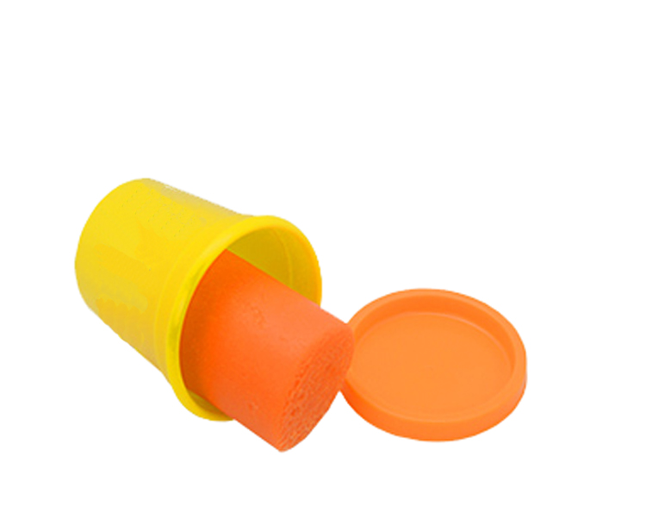
Part of the product display
Case of Colors has plenty of non toxic playdough modeling compound for the whole family to shape and create
延迟符

Slide 16
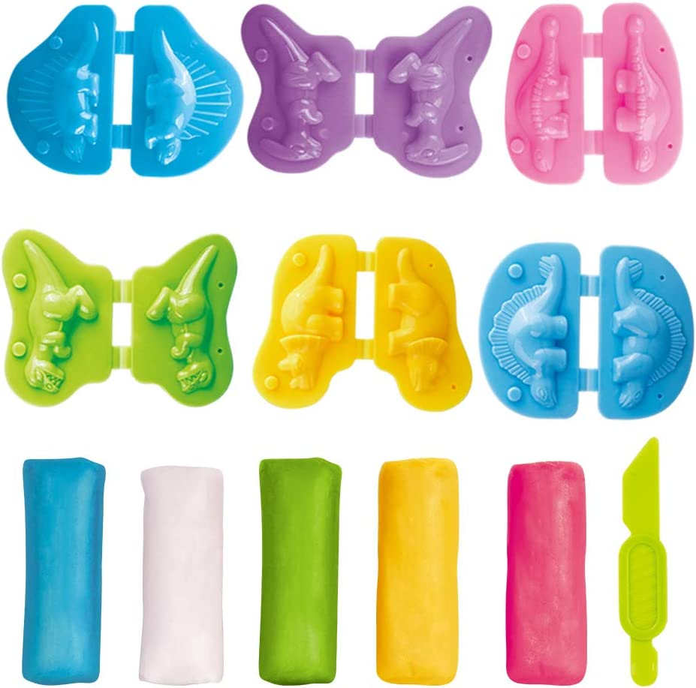
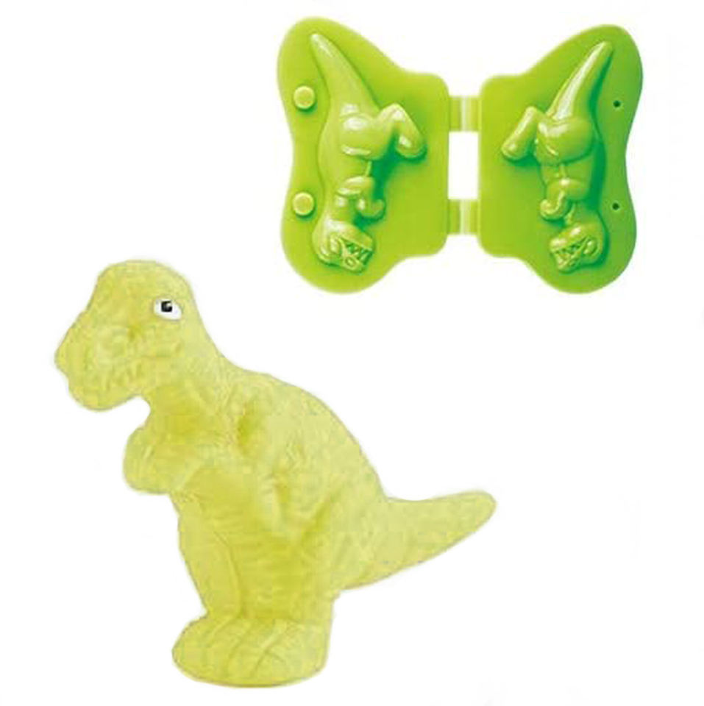
Part of the product display
Case of Colors has plenty of non toxic playdough modeling compound for the whole family to shape and create
延迟符

Slide 17
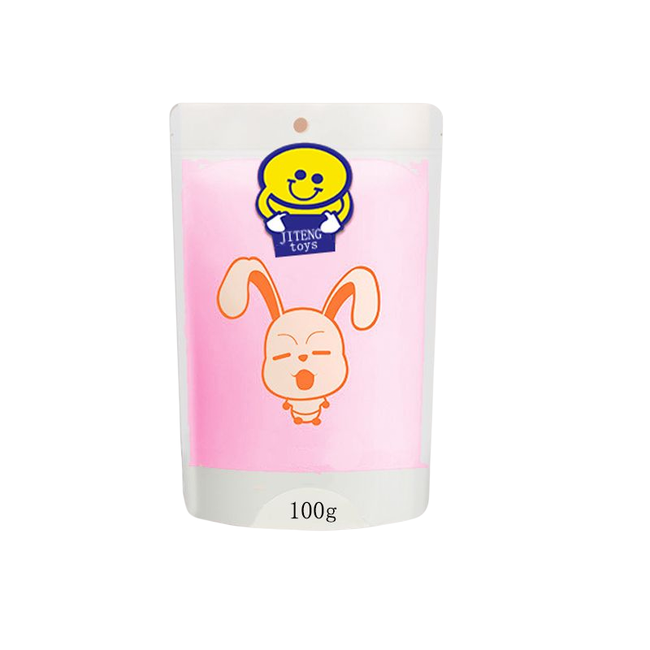
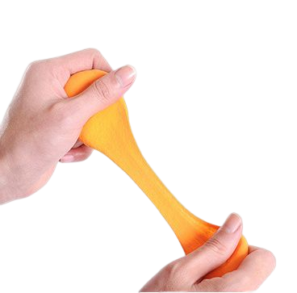
Part of the product display
Case of Colors has plenty of non toxic playdough modeling compound for the whole family to shape and create.
延迟符

Slide 18
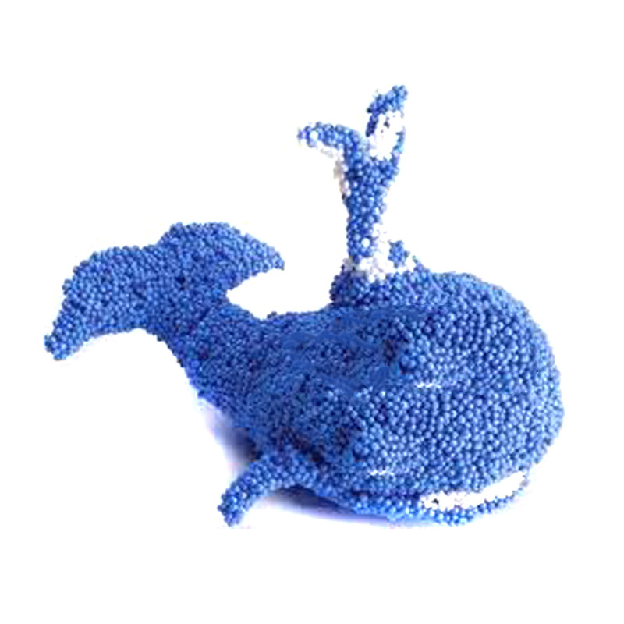
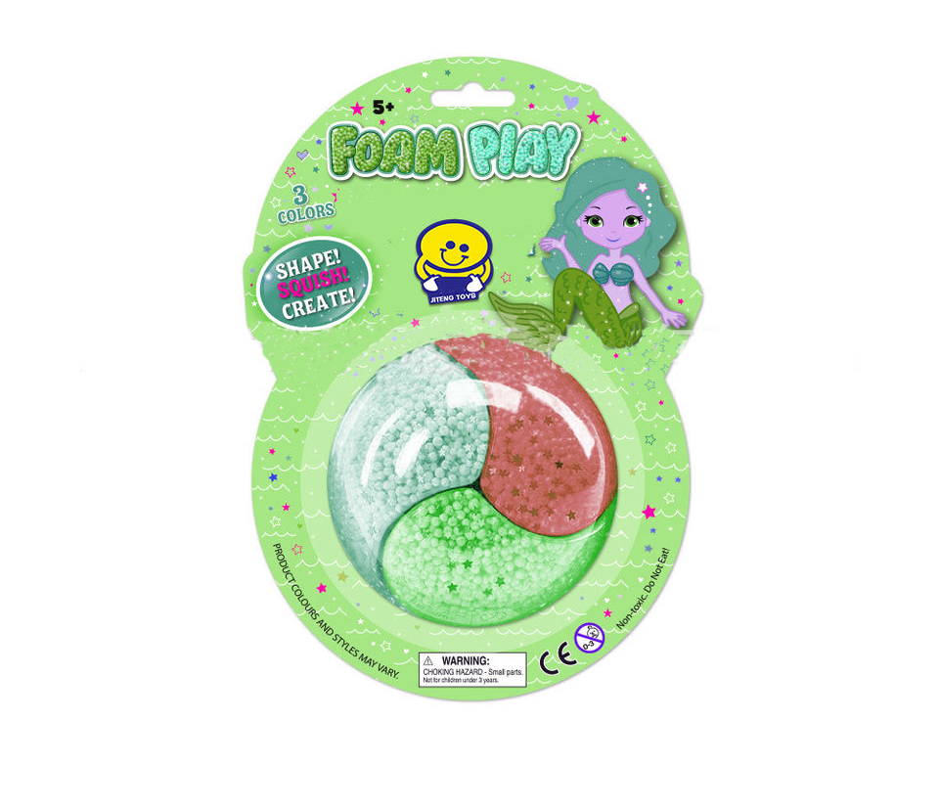
Part of the product display
Just squish up the Playfoam, shape it however you like, then squash it back down and start all over again
延迟符

Slide 19
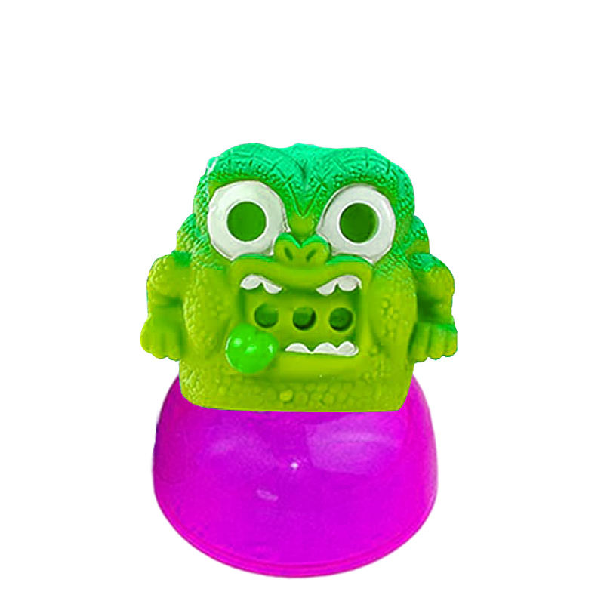
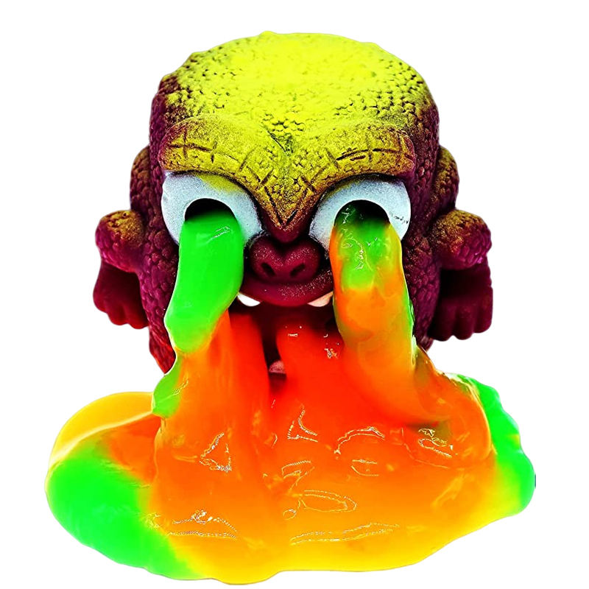
Part of the product display
vomiting monster, you can suck the monster until you spit it out
Just squeeze it and make it fun
延迟符

Slide 20
If you want more products, please log in
www.slimytoys.com
www.toyslime.com
延迟符

Slide 21
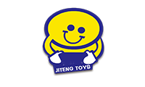
YIWU JITENG TOYS CO.,LTD
.
Address：FLOOR 1-4, 5TH BUILDING, NO.111 OF HUACHUAN NORTH ROAD, CHI'AN TOWN,
TEL：+8613646895313 +8613857972335
Emai:stone@jitengtoys.com
延迟符

